Slide 1

Bird
Samir Hauser, Connor Charlton, Joel Alder

Slide 2

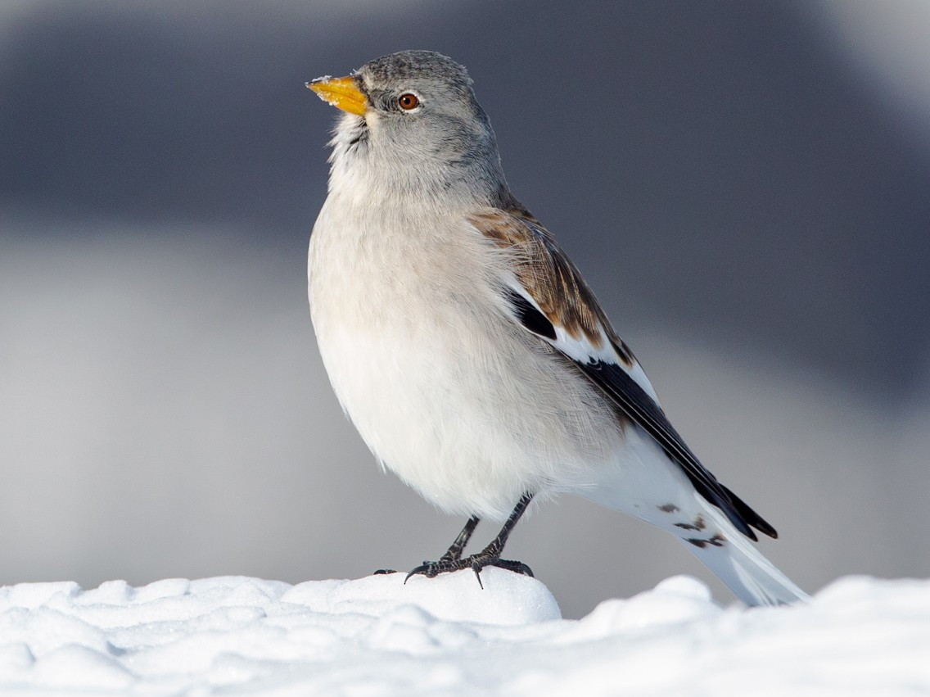
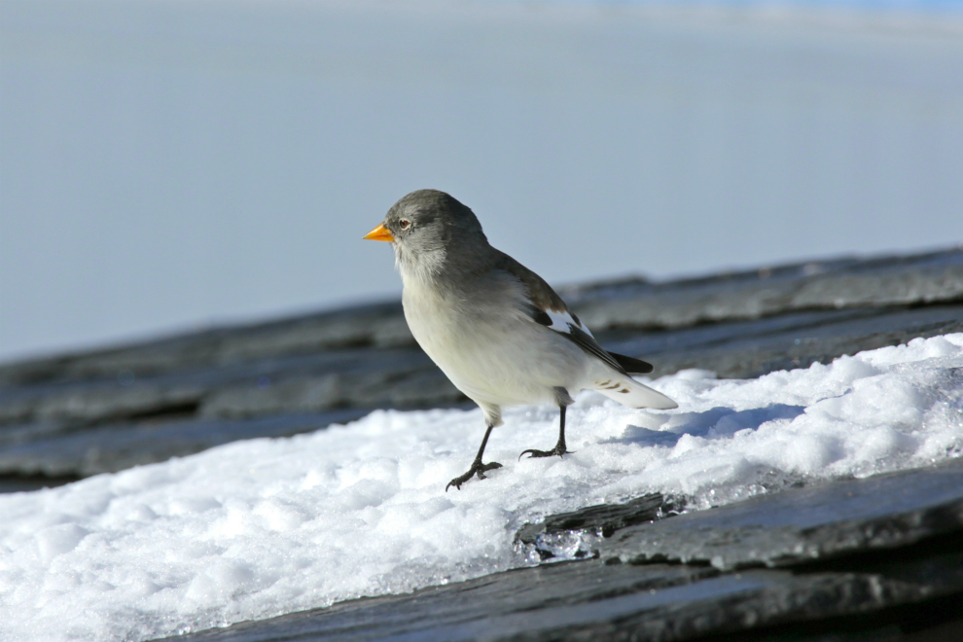
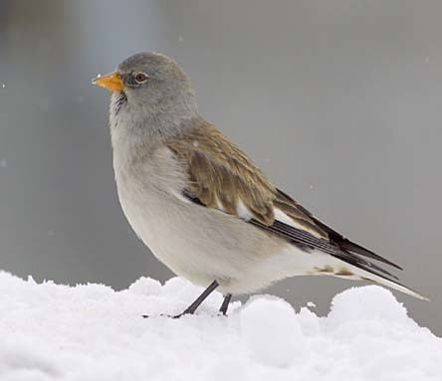
Snow-finches

Slide 3
Background
Can’t visually sex the bird with the desired level of accuracy
Survival chance of snow-finches depends on their sex
Capture the birds and measure morphological traits (weight, feather length, etc.)
Researchers determine the sex via a salivary swab and subsequent gene test
Main Goal: Build a probabilistic classification model that predicts sex based on morphological traits more accurately than the experts can by visual inspection

Slide 4
Research Question
Develop a model that returns the probability of each sex based on the morphological traits
Identify which morphological traits are important (explain the most variance in sex), so that they can evaluate whether investing resources into measuring morphological traits with less predictive power is worthwhile in the future - they can do this better than we can, because they know which traits are harder or easier to measure

Slide 5
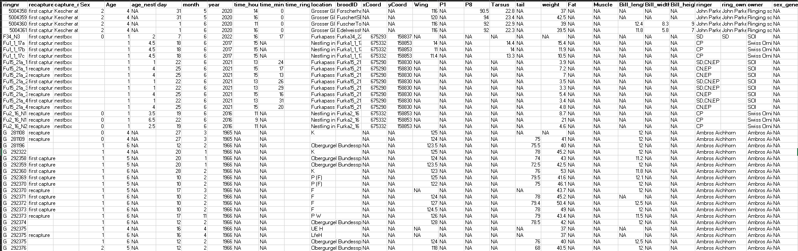
Overview of Data

Slide 6
Data
Variable | Description
Age | 1 = nestling , >1 : adult bird
Wing | length in mm
P1 / P8 | feather length
Tarsus | leg length
Weight | in g (strongly varies with time of year)
Fat | (0 = lean, 6 = fat)
Muscle | (0 = hardly any muscle, 3 = a lot of muscle)
Bill length | In mm
Sex | Sex guess of the person who collected it
Ringer | Person which collected the data
Location | Place where the birds were collected
Time | When the data was collected
Sex_genetic | Sex determined via gene test
Sample size:
Total: 2,287
Nestlings: 706

Slide 7
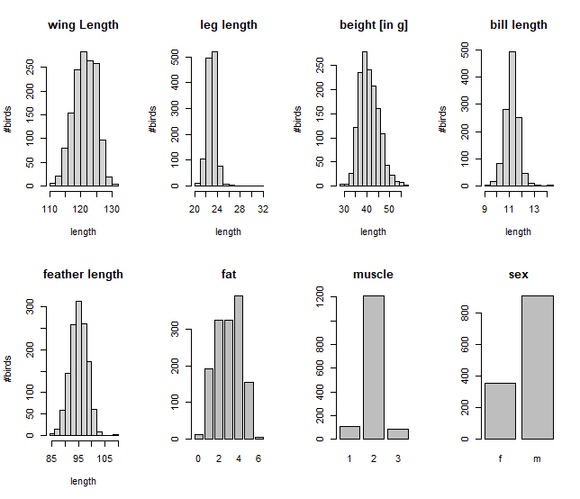
Adult bird data
1561 adult observations
Variable | NaN | % of total
Wing | 135 | 6.5%
Tarsus | 349 | 22.4%
Bill length | 375 | 24.0%
Feather length | 267 | 17.1%
Weight | 92 | 5.9%
Fat | 160 | 10.3%
Muscle | 158 | 10.1%
Sex (genetics) | 298 | 19.1%

Slide 8
Crosstable of adult brid data
Only adult bird data:
5 locations cover approx. 84% of all observations.
Age category 4 is the most frequent.
Age and sex frequency is largely identical across the observed locations.
Corviglia deviates slightly from this.
 |  |  | AGE
 |  |  | 2 | 4 | 5 | 6
LOCATION | Arosa | female | 0% | 27% | 3% | 0% | 31%
 |  | male | 0% | 52% | 9% | 8% | 69%
 |  |  | 0% | 80% | 13% | 8% | 100%
 | Corviglia | female | 4% | 16% | 2% | 1% | 22%
 |  | male | 18% | 56% | 0% | 4% | 78%
 |  |  | 22% | 72% | 2% | 5% | 100%
 | Distelboden | female | 3% | 27% | 4% | 0% | 35%
 |  | male | 5% | 51% | 4% | 5% | 65%
 |  |  | 8% | 78% | 8% | 5% | 100%
 | Nante | female | 1% | 31% | 0% | 0% | 32%
 |  | male | 5% | 63% | 0% | 0% | 68%
 |  |  | 6% | 94% | 0% | 0% | 100%
 | Tiefenbach | female | 0% | 25% | 1% | 1% | 27%
 |  | male | 3% | 64% | 0% | 6% | 73%
 |  |  | 3% | 89% | 1% | 7% | 100%

Slide 9
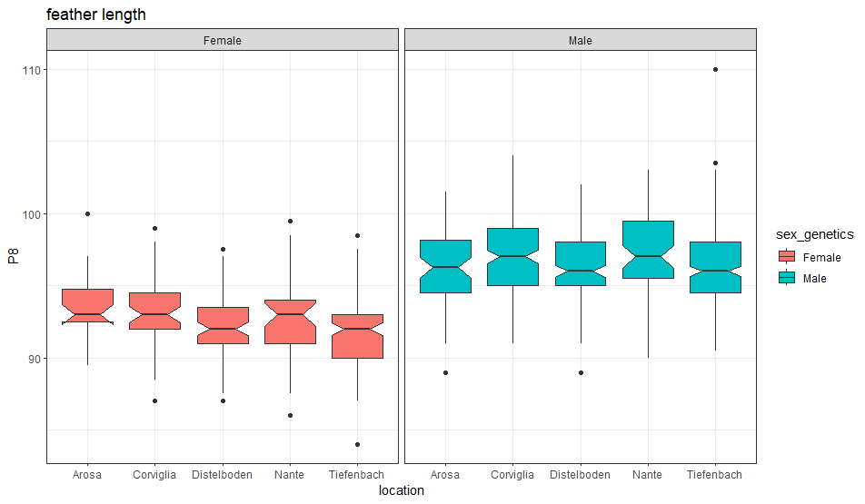
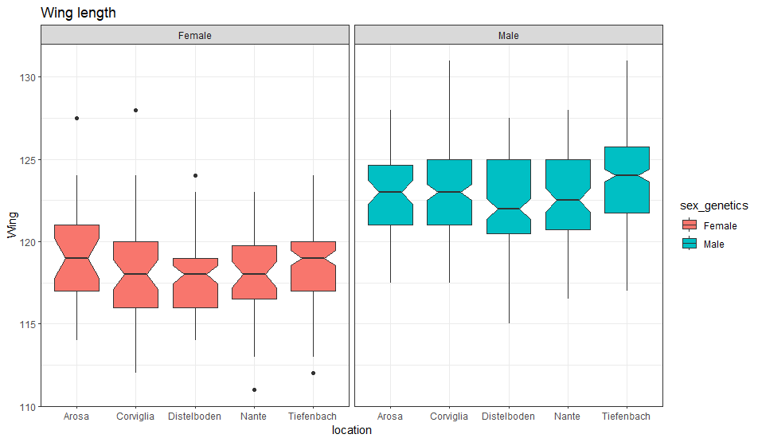
A first glance Promising Variables I covariates
 |  | AGE
 |  | 2 | 4 | 5 | 6
Location | Arosa | 0% | 80% | 13% | 8%
 | Corviglia | 22% | 72% | 2% | 5%
 | Distelboden | 8% | 78% | 8% | 5%
 | Nante | 6% | 94% | 0% | 0%
 | Tiefenbach | 3% | 89% | 1% | 7%
Feather length
Wing length

Slide 10
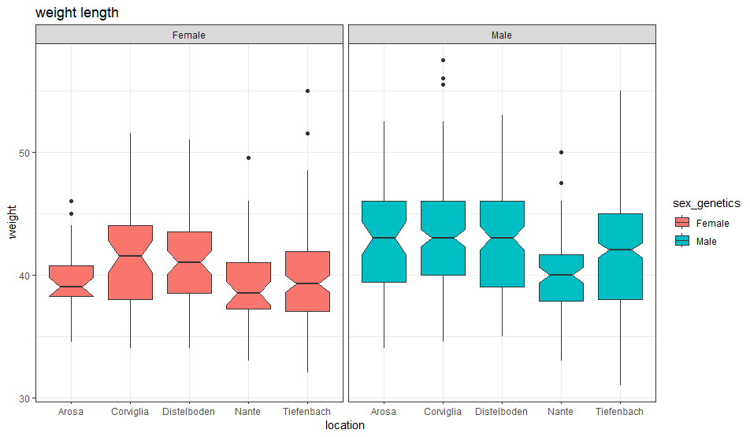
A first glance Promising Variables II covariates
 |  | AGE
 |  | 2 | 4 | 5 | 6
Location | Arosa | 0% | 80% | 13% | 8%
 | Corviglia | 22% | 72% | 2% | 5%
 | Distelboden | 8% | 78% | 8% | 5%
 | Nante | 6% | 94% | 0% | 0%
 | Tiefenbach | 3% | 89% | 1% | 7%
Morphological traits such as:
Feather length, Wing length and Weight might be different between male and female birds.
Weight

Slide 11
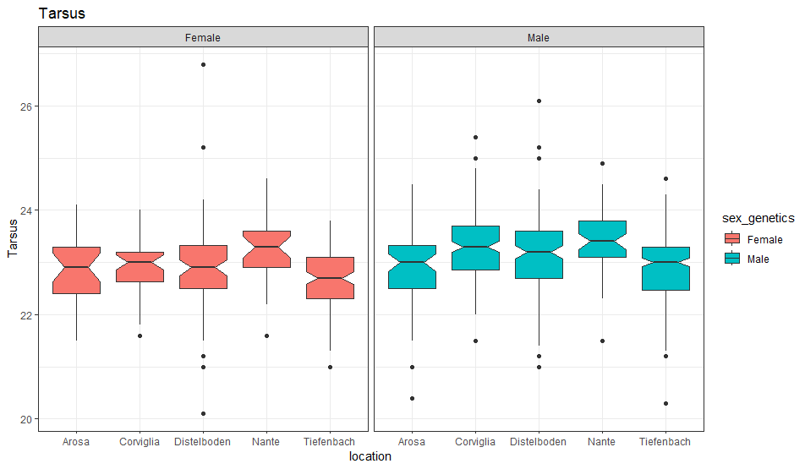
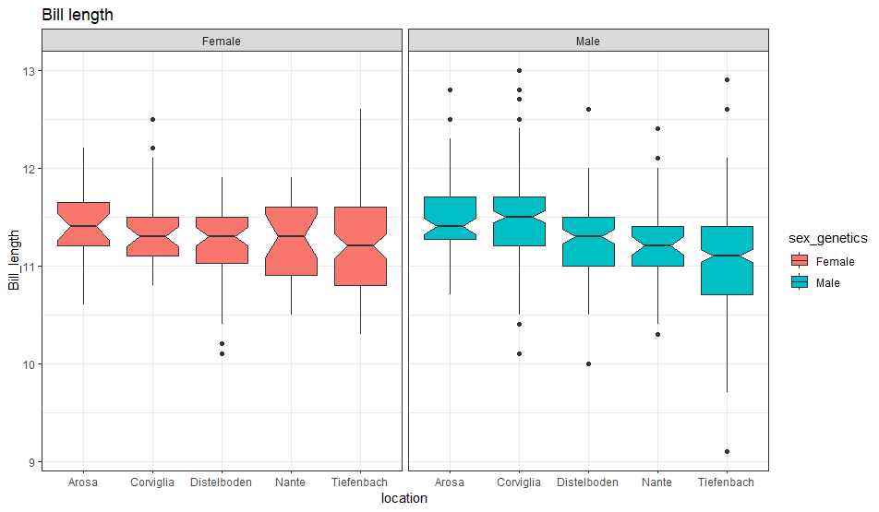
A first glance Promising Variables III covariates
 |  | AGE
 |  | 2 | 4 | 5 | 6
Location | Arosa | 0% | 80% | 13% | 8%
 | Corviglia | 22% | 72% | 2% | 5%
 | Distelboden | 8% | 78% | 8% | 5%
 | Nante | 6% | 94% | 0% | 0%
 | Tiefenbach | 3% | 89% | 1% | 7%
Tarsus
Bill length

Slide 12
How good is an expert’s guess?
It was guessed (by eye), by the ringer (specialist taking the measurements), whether each bird is male or female in 415 observations.
A correct classification was achieved in 93.2% of these observations.
However, we do not know if they only made guesses in cases where they were very confident or whether the cases in which they made guesses were selected randomly.
Where are the mistakes?

Slide 13
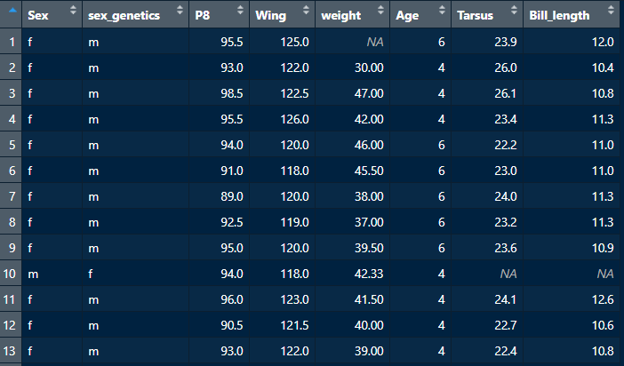
How good is an expert’s guess?
It was guessed (by eye), by the ringer (specialist taking the measurements), whether each bird is male or female in 415 observations.
A correct classification was achieved in 93.2% of these observations.
However, we do not know if they only made guesses in cases where they were very confident or whether the cases in which they made guesses were selected randomly.
Where are the mistakes?
Feather length
Wing length

Slide 14
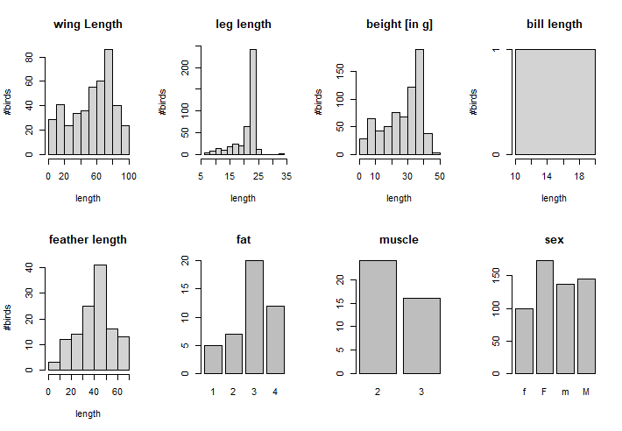
Nestling bird data
706 nestling observations
Variable | NaN | % of total
Wing | 277 | 39.2%
Tarsus | 280 | 39.7%
Bill length | 705 | 99.8%
feather length | 582 | 82.4%
weight | 23 | 3.3%
Fat | 662 | 93.8%
Muscle | 158 | 94.3%
sex_genetics | 152 | 21.5%

Slide 15
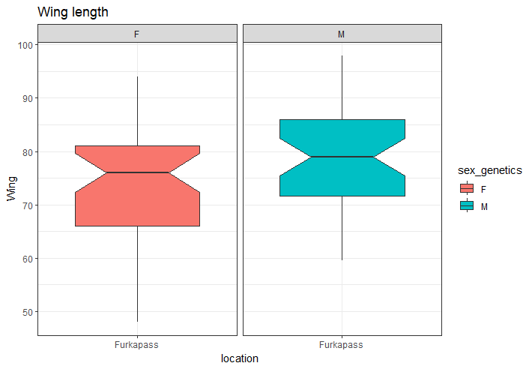
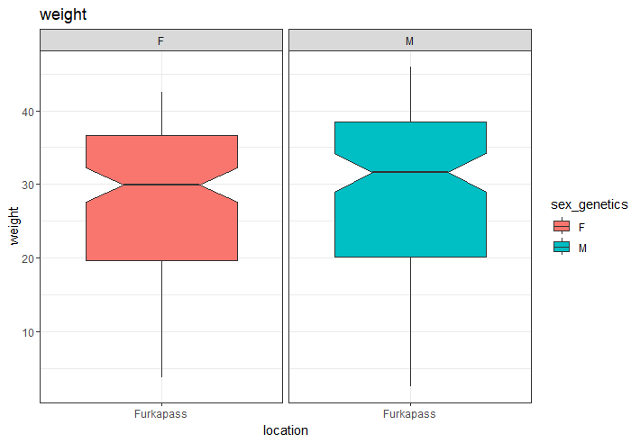
A first glance AT Nestling data I

Slide 16
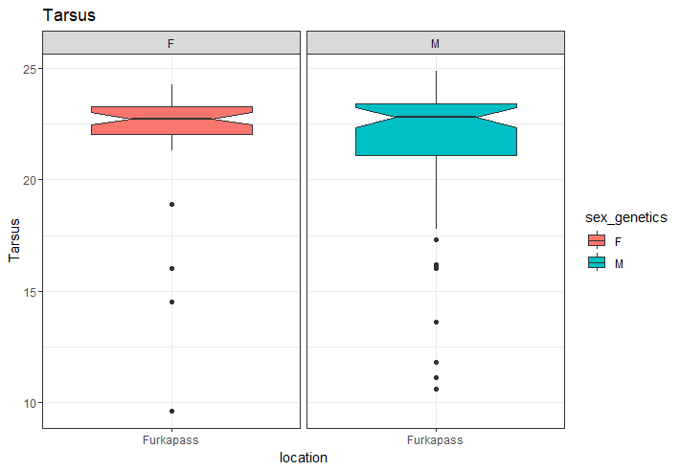
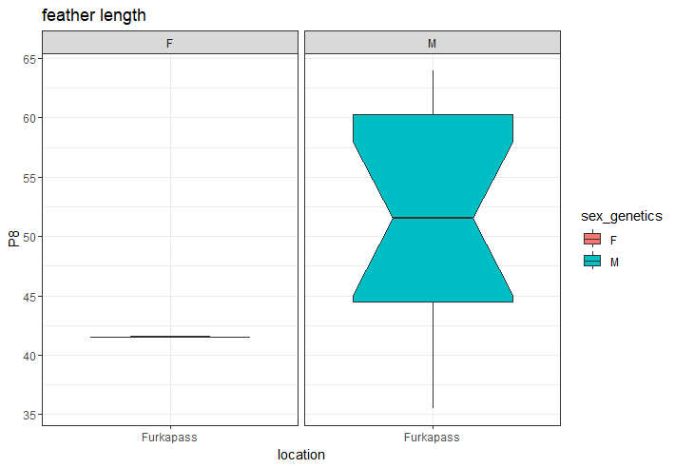
A first glance AT Nestling data II

Slide 17
THREE Main questionS
How should we impute the missing values?
For nearly every bird at least one measurement is missing.
Should the nestlings’ sexes be predicted using a different model?
Should the model make use of the expert’s guess, in cases where a guess was made?
We could use not only the guess made but also which ringer made the guess, in case some ringers guess much more accurately than others.
The client asked for a model which predicts using only the morphological traits, but that seemed to be because she was opposed to the idea of using a subjective input. Should we to try to convince her that a model using all available data is better?

Slide 18
IMPUTING the missing values
Treat NA as a value in itself (i.e. make it a factor level): Information regarding correlation between predictor variables can be lost and this approach only works for categorical variables, because what order is assigned to the NA value when it is used to impute an ordinal or continuous variable?
Impute missing values using k-NN classification and regression: If a distance measure can be defined for incomplete vectors, missing values can be imputed by taking the weighted mean/mode of the k-nearest neighbours which have values for the missing variable. However, such a distance measure, if defined naively, will violate the triangle inequality. Moreover, k-NN imputation can have very distortive effects, because column variance may be greatly reduced. Nonetheless according to Jadhav et. al, it still outperforms mean imputation, median imputation, predictive mean matching, Bayesian linear regression, non-Bayesian linear regression, and random sampling.
Impute missing values using multiple imputation by chained equations (MICE)

Slide 19
MICE
Multiple imputation involves stochastically imputing all missing values multiple times, running a classification model each time and pooling the results (returning the modal classification).
Multiple imputation by chained equations is multiple imputation in which each imputation is made via an initial column-wise imputation and then iteratively updated by cyclically running regression/classification on each column.
It has been empirically demonstrated to be very effective on datasets where the missing values are MCAR or MAR, so if this assumption holds in our case it’s almost certainly the optimal imputation method.

Slide 20
Plan of Action
Randomly partition the data instances p times into 90%:10% training-to-testing sets.
For each partition, run the 3 possible imputation methods including MICE with a variety of initial imputation methods and a variety of regression/classification methods.
For each imputation, run a few different classification models.
Record the average performance of each imputation-classification pair across the p data partitions and select the best performing pair as our model-of-choice.
Examine the influence of each predictor variable under this model and report which variables have negligible predictive power
Classification
Logistic Regression
Trees & Random Forest

Slide 21
Overview of the data for the different time

Slide 22
First resutls of a logistic model

